Slide 1


E-commerce Product Categorization Using ML and Deep Learning
This presentation explores the use of machine learning and deep learning to automate product categorization in e-commerce, a crucial aspect of improving user experience, product discoverability, and search functionality.
by roundtable STUDIO

Slide 2
Problem Overview: Search Inefficiencies in Manual Product Categorization
Search Limitations with Manual Categorization
Impact on Search Accuracy and Efficiency
Overall Impact on E-commerce
The combined effect of manual categorization's limitations on search accuracy and efficiency significantly reduces e-commerce performance. Poor search results lead to frustrated customers, lower conversion rates, and diminished customer loyalty. A robust, scalable solution is needed to address these challenges and ensure efficient and accurate product discovery.
Manual product categorization significantly impacts search functionality. Inaccuracies or inconsistencies in manual tagging lead to products being miscategorized, making them difficult or impossible to find through keyword searches. This results in poor user experience and lost sales opportunities.
Manual categorization introduces inherent limitations on the accuracy and efficiency of search algorithms. The time-consuming nature of manual tagging means updates lag behind product introductions and changes, resulting in outdated search indexes and reduced relevance. Inconsistent tagging further complicates search by creating ambiguity and hindering retrieval.

Slide 3
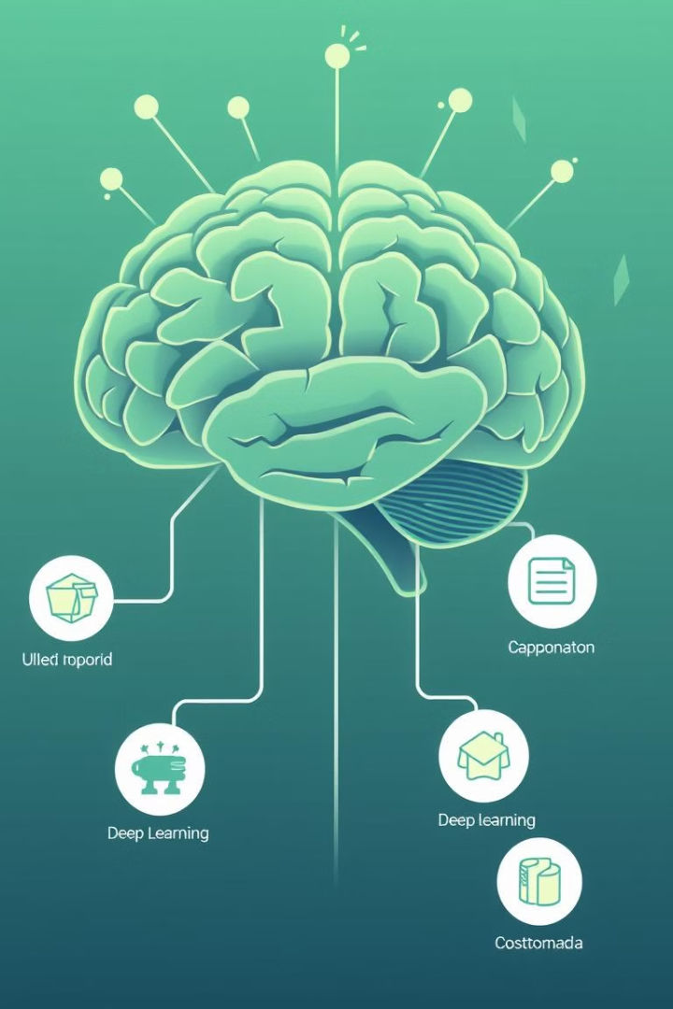
1
Embark on the data journey by loading the dataset
2
Uncover hidden gems through exploratory data analysis for valuable business insights
3
Craft a data masterpiece using NLTK for preprocessing and feature engineering
4
Translate words into numbers magic with techniques like TF-IDF or word2Vec
5
Divide and conquer with train-test split using stratify sampling
6
Train and unleash the power of various machine learning and deep learning models
7
Fine-tune for perfection using hyperparameter tuning
8
Crystal ball time - get our predictions
9
May the best model win - compare and crown the top performer

Slide 4
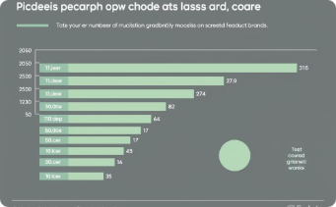
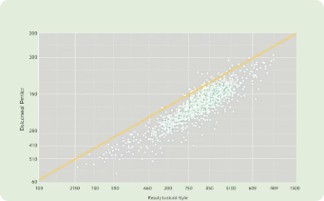
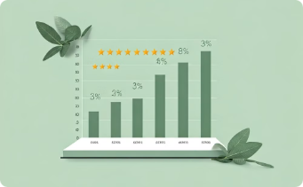
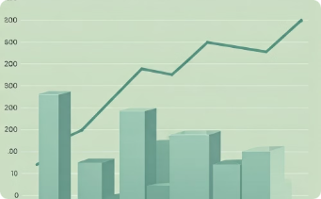
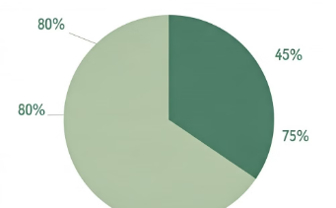
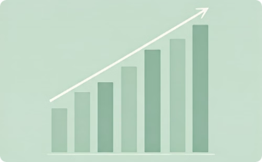
Key Insights
leading brands showcasing a wide range of products on the platform.
greater discounts with every increase in retail price
ratings on different product categories
highest average and discounted price on product category
percentage breakdown
top selling category
based on product category
based on ratings

Slide 5
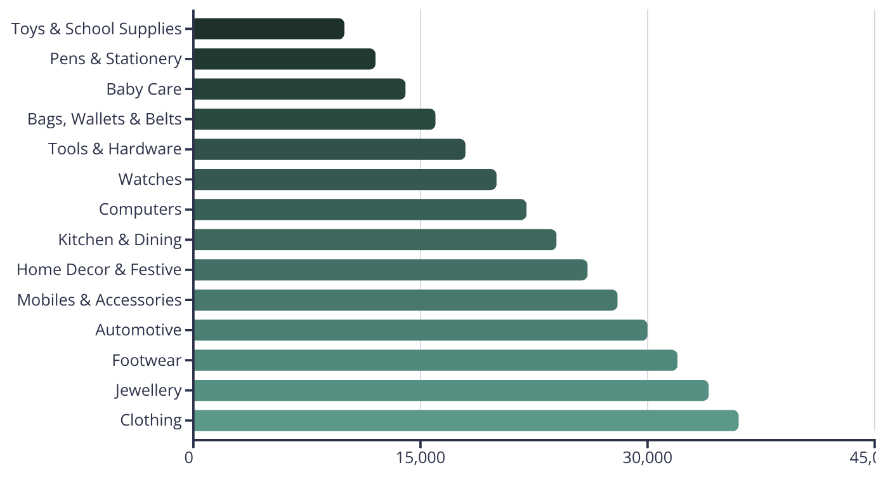
Product Categories by Sales
This chart showcases sales performance for different product categories, providing insights into customer preferences and market trends.

Slide 6
Methodology
Data Collection
1
Gathering product data from various sources, including e-commerce platforms, product catalogs, and external databases.
2
Data Preprocessing
Cleaning, transforming, and preparing data for model training, including text normalization, feature extraction, and image resizing.
Model Selection
3
Choosing appropriate ML or deep learning algorithms, considering factors such as data size, complexity, and desired performance.
4
Model Training
Training the chosen model using the prepared data, optimizing hyperparameters to achieve high accuracy and performance.
Model Evaluation
5
Assessing the trained model's performance using relevant metrics, such as precision, recall, and F1-score.
6
Model Deployment
Integrating the trained model into the e-commerce platform for real-time product categorization and recommendation systems.

Slide 7




Incorporating Multimodal Data for Improved Accuracy
Image Recognition
Extracting features from product images using deep learning models, such as Convolutional Neural Networks (CNNs), to identify objects, shapes, and patterns.
Text Processing
Analyzing product descriptions and user reviews using Natural Language Processing (NLP) techniques, such as word embedding and sentiment analysis, to understand textual content.
Fusion Techniques
Combining image and text features to create a more comprehensive representation of the product for improved categorization accuracy.

Slide 8



Hierarchical and Multi-level Categorization Approaches
Top-level Categories
1
Broad categories, such as "Electronics," "Clothing," or "Home & Kitchen," provide initial filtering and navigation.
Subcategories
2
More specific categories, such as "Smartphones" within "Electronics," allow users to refine their search.
Fine-grained Categories
3
Detailed categories, such as "Android Phones" under "Smartphones," provide precise product identification.

Slide 9
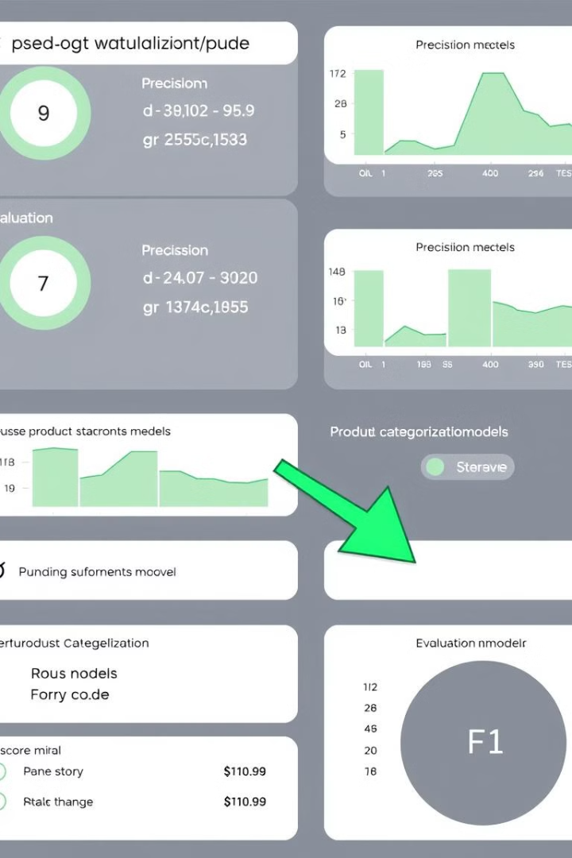
Evaluation Metrics and Benchmarking for Product Categorization Models
95%
90%
Precision
Recall
Measures the accuracy of the model's predictions.
Indicates the model's ability to identify all relevant products.
92%
F1-Score
A combined metric that balances precision and recall.

Slide 10
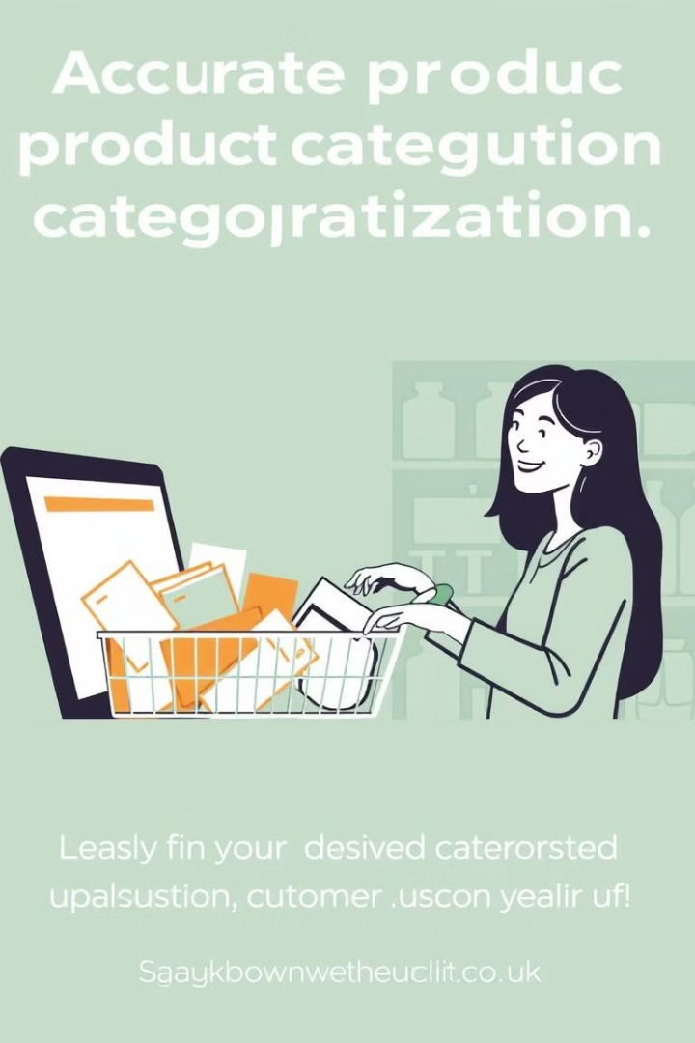



Business Impacts
Improved User Experience
Enhanced Search Functionality
Enhanced product discoverability and navigation lead to a more satisfying online shopping experience.
More accurate search results improve customer satisfaction and conversion rates.
Increased Revenue
Improved user experience and search functionality drive sales growth and increased revenue.

Slide 11
Best Practices and Future Trends in E-commerce Product Categorization
Data Quality
1
Ensure accurate and consistent product data for optimal model performance.
Continuous Improvement
2
Regularly monitor and refine categorization models to adapt to changing product trends and market dynamics.
Personalized Categorization
3
Tailoring categorization systems to individual customer preferences and browsing history.
Multi-lingual Support
4
Developing models capable of handling product information in multiple languages.

